Slide 1
Symphony of the Scriptures
Jonah
Notes:
Who wrote the book?
The book of Jonah, written primarily in the third person, does not explicitly name the prophet as the author of his own account, but we have no reason to doubt either the inspiration or the historical veracity of the book. Identified in verse 1 as the son of Amittai, Jonah came from a town called Gath-hepher, near Nazareth in the area that later came to be known as Galilee (2 Kings 14:25). This makes Jonah one of the few prophets who hailed from the northern kingdom of Israel.
Where are we?
During Jonah’s years as a prophet, Israel stood tall among the nations, though in a political rather than a spiritual sense. The reign of Jeroboam II (793–753 BC), who was an evil king before the Lord, saw Israel’s borders expand to their greatest extent since the time of Solomon. Increased prosperity resulted in a materialistic culture that thrived on injustice to the poor and oppressed, one of the key messages of Jonah’s prophetic contemporary, Amos.
However, rather than direct Jonah to prophesy to his own people, God commissioned him to the Assyrian capital of Nineveh. At first unwilling to make the journey northeast to deliver God’s message, Jonah turned and aimed for the farthest westward point known to him—Tarshish, located in modern-day Spain. After God eventually turned Jonah in the right direction, the prophet obediently prophesied to the people of Nineveh while Ashurdan III (772–754 BC) sat on the throne of Assyria. Though Assyria had been in a politically weakened state for some time, by the time of Jonah their cruelty to captives and other undesirables was well-known in Israel, creating an obvious need for Jonah’s message of repentance.
Why is Jonah so important?
Jonah was one of only four writing prophets that Jesus mentioned by name during His earthly ministry (Isaiah, Daniel, and Zechariah were the others). But Jonah received more than a mere mention. Jesus actually identified Himself with the prophet’s three-day sojourn in the belly of the great fish, noting it as a foreshadowing of His own death, when Jesus would spend three days “in the heart of the earth,” before His resurrection (Matthew 12:39–41). Jesus’s identification with the prophet at the lowest point of Jonah’s life finds echoes in the book of Hebrews, where it teaches that Jesus “had to be made like His brethren in all things, so that He might become a merciful and faithful high priest” (Hebrews 2:17). The book of Jonah stands as an important link in the prophetic chain, giving readers a glimpse of Christ’s death and resurrection hundreds of years before they actually occurred.
What's the big idea?
When the call of God came to him, Jonah could not see beyond his own selfish desire for God to punish the Assyrians. How could God want him to take a message of mercy to such people? Before Jonah could relay God’s message, he had to be broken. He had to learn something about the mercy of the Lord. Through his flight to Tarshish, his shipwreck, and his time in the great fish, Jonah was convinced in a powerful way that all salvation comes from the Lord (Jonah 2:9). And because of God’s supreme power, only God decides where to pour out His salvation and His mercy (4:11).
Jonah’s name means "Dove” --- His book does not contain prophecy per se, rather it contains the history of a prophet...
A prophet reluctant to fulfill the mission God assigned him
A prophet who complained when his mission proved successful -- What kind of prophet is that? Perhaps one that reveals what may be true of ourselves!
This short book of "Jonah" easily falls into four sections...
I. "Running Away From God" (chapter one)
II. "Running To God" (chapter two)
III. "Running With God" (chapter three)
IV. "Running Ahead of God" (chapter four)

Slide 2
Jonah
783 B.C. - 753 B.C. circa
Name means “Dove”
…”for I knew that you are a gracious God and merciful, slow to anger and abounding in steadfast love, and relenting from disaster”
(4:2b)
Running
from God
Running
to God
Running
with God
Running
ahead of God
First commission
of Jonah
Results of disobedience
Prayer of Jonah
Communication
with the Lord
Second commission of Jonah
Results
of obedience
Prejudice of Jonah
Lessons from the Lord
Chapter 2
Chapter 1
Chapter 3
Chapter 4
Theme
God’s infinite mercy for all people; our reluctance to share His mercy
Key Verses
2:9; 4:11
Jonah’s three days in the fish anticipates Christ’s death and resurrection.
The Ninevites’ salvation represents the salvation available to all people
in Christ (Mt. 12:39-41; Lk. 11:29-32)
Christ in
Jonah
Notes:
Jonah has the dubious honor of being the only prophet who ran away from his commission. However, God caught up with him and brought him to his knees. Jonah barely tells us anything about himself prior to his calling to Nineveh (Assyria) -- only that he was the son of Amittai. However, 2 Kings 14:25 tells us that Israel’s king, Jeroboam II “He restored the border of Israel from Lebo-hamath as far as the Sea of the Arabah, according to the word of the Lord, the God of Israel, which he spoke by his servant Jonah the son of Amittai, the prophet, who was from Gath-hepher.” We know that Jeroboam II reigned in the northern kingdom from 793-753 B.C. That means Jonah would have ministered in the northern kingdom at least thirty years prior to Assyria’s invasion of Israel in 722 B.C. Nineveh was the capital of Assyria. It could be that Jonah heard of Assyria’s impending invasion from other prophets, like Amos. If so, that would be one reason why Jonah fled as he did. Since Jesus uses Jonah’s imprisonment by the great fish as a foreshadowing of his death and resurrection, it argues against the idea that the book is allegorical or mythical, as some suggest. Unlike most other prophetic portions of the Old Testament, Jonah is a narrative of a single prophetic mission - to Nineveh - the great enemy and menace of Israel. The book can be divided into two commissions: (1) In chapters 1-2, he refused the first commission; (2) In chapter 3-4, after being pursued and humbled, Jonah obeys the second commission to preach to the Ninevites (although he wasn’t happy about it, 4:1). A brief outline has him running from God (chapter 1); running to God (chapter 2); running with God (chapter 3); running against God (chapter 4). I find it interesting that God answers Jonah’s self pity (where he uses a plant to sprout up and wither as a lesson that even the Ninevites deserved compassion) with a rhetorical question that closes out the book: “And should not I pity Nineveh, that great city, in which there are more than 120,000 persons who do not know their right hand from their left, and also much cattle?” Note: the inference that the 120,000 did not know their “right hand from the left” possibly implies a state of innocence making the number of inhabitants much greater (thought to be about 600,000 when it was captured in 612 B.C.).
Application
Be careful we do not become judgmental: salvation depends on God, not us. That’s a good thing. Like Jonah, we might be less gracious and merciful than God is (as demonstrated with the Ninevites).
Be careful about deciding who is worthy of salvation: the Pharisees griped about Jesus fraternizing with the sinners and publicans. Yet the spiritually sick are the very ones needing the gospel.
Be careful you do not see yourself as superior: The gospel is a the great equalizer and everyone deserves to hear it.
God longs after people. He wants the sinners outside (like Nineveh) to repent, and He wants sinners inside (like Jonah - he certainly had warts) to love the sinners who are outside.
Key thought: How about us? Is there anyone we are withholding the gospel from because we think their sin is too great and they are undeserving?

Slide 3
The Book of Jonah
The only information the book provides on Jonah himself is that he is the son of Amittai. However, 2 Kings 14:25 tells us that he was from Gath-hepher and Joshua 19:12-13 tells us that is located in Zebulun, which is in the northern kingdom, Israel, west of the Sea of Galilee.
2 Kings 14 also tells us that Jonah prophesied during the reign of Jeroboam II, whom we know reigned from 793 to 753 BC. This was a generation before Israel was taken into Assyrian captivity in 722 BC.
Jonah is one of only three books where the prophets preached only to nations outside of God’s people. (The others are Nahum, who also preached to Nineveh, and Obadiah, who preached against Edom.)
One of the shortest books in the Old Testament – only 48 verses – Jonah provides a strong message for all Christians regarding preaching God’s message and who might be receptive. It is a well known story. Jonah may be the most recognized minor prophet.

Slide 4
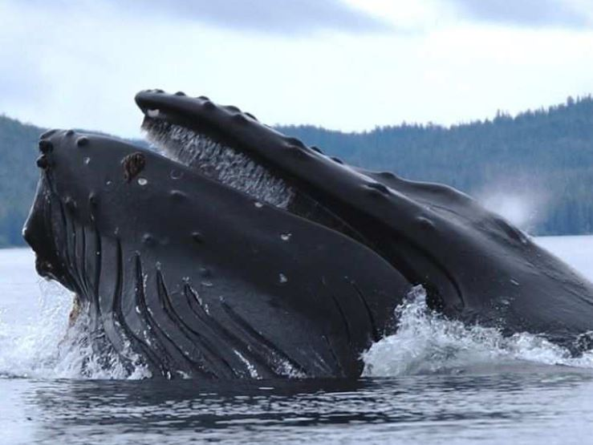
On June 11, commercial lobster diver Michael Packard was nearly swallowed whole by a humpback whale off the coast of Provincetown, Massachusetts, reports Doug Fraser for the Cape Cod Times. The encounter only lasted about 30 seconds before the whale resurfaced and belched out Packard. Once back into the water, Packard’s crewmates pulled him to safety and immediately transported him to Cape Cod Hospital, reports Rachel Treisman for NPR. Except for serious bruising and a dislocated knee, Packard escaped virtually unscathed.
The once-in-a-lifetime encounter occurred while Packard
was about 45 ft deep into the water searching for lobsters.
Then, he felt a huge push, almost like a “truck hit me and everything just went dark,” he said in an interview with WBTS. Packard initially thought a great white shark had attacked him, the Cape Cod Times reports.
“Then I felt around, and I realized there was no teeth, and I had felt, really, no great pain,” recounted Packard to WBTZ-TV News. “And then I realized, “Oh my God, I’m in a whale’s mouth. I’m in a whale’s mouth, and he’s trying to swallow me.”
While inside the whale, Packard – with his scuba gear and breathing apparatus still on – began to move around to try and escape. By Packard’s estimate, about 30 to 40 seconds passed before the whale began to move its head from side to side.

Slide 5
Jonah 1:17
Now the LORD had prepared a great fish to swallow Jonah.
had prepared
And Jonah was in the belly of the fish three days and three nights.
Matt 12:40 "For as Jonah was three days and three nights in the belly of the great fish, so will the Son of Man be three days and three nights in the heart of the Earth.”
Jesus uses Jonah as a parallel, or “type,” for what is about to happen to Him.

Slide 6
Period | History Covered | Scriptures | Years | Principal
Antediluvian | Creation to the Flood | Gen. 1-7 | 1656 | Adam
Postdiluvian | From the flood to call of Abraham | Gen. 8-!1 | 427 | Noah
Patriarchal | From the call of Abraham to Egyptian Bondage | Gen. 12-45 | 215 | Abraham
Egyptian Bondage | From Egyptian Bondage to the Exodus | Gen. 46-Ex. 11 | 215 | Joseph
Wilderness Wanderings | From Exodus to crossing of the Jordan | Ex. 12-Deut. 34 | 40 | Moses
Conquest of Canaan | From crossing of Jordan to Joshua’s death | Josh. 1-24 | 51 | Joshua
Judges | From Joshua to King Saul | Ju, Ruth, 1 Sa. 1-9 | 305 | Samuel
The United Kingdom | From origin of kingdom to its division | 1 Sa. 9-1 Ki. 11; 1 Chr. 10, 2 Chr. 9 | 120 | David
The Divided Kingdom | From the division to the fall of Israel | 1 Ki. 12-2 Ki. 20; 2 Chr. 10-32 | 253 | Elijah
Judah Alone | From fall of Israel to the fall of Judah | 2 Ki. 21-25; 2 Chr. 10-32 | 125 | Josiah
Babylonian Captivity | From the fall of Judah to the return | 2 Ki. 25-8- 21; Dan. 1-6; Ezekiel | 70 | Daniel, Ezekiel
Restoration of the Jews | From the return to end of OT history | Ezra, Nehemiah | 92 | Ezra
Between the Testaments | From end of OT to the beginning of the NT | None | 400 | Judas Maccabe
Life of Christ | From birth of Jesus to ascension | Mt-Jhn 21; Acts1 | 34 | Jesus
The Church | From ascension to death of Paul (96 AD approx.) | Acts 2-Revelation | 70 | Paul

Slide 7
CHRONOLOGY OF PROPHETS
9th Century
Prophets
Assyrian Exile - Israel 722 BC
Babylonian Exile- Judah 586
8th Century
Prophets
7th and 6TH
Century
Prophets
Exilic
Prophets
Postexilic
Prophets
Jonah
Amos
Hosea
Haggai
Zechariah
Malachi
Israel
Daniel
Ezekiel
Obadiah
(early date)
Joel
Isaiah
Isaiah
Nahum
Zephaniah
Habakkuk
Jeremiah
Obadiah
(late date)
Judah
Micah
Major prophets in bold, italics

Slide 8
Jonah
760 BC
Nahum
630 BC
Minor
Prophets
Timeline
Nineveh
Amos
755 BC
Hosea
750 BC
Israel
722
BC
586 BC
Divided
Kingdom
930 BC
536 BC
Judah Exile Return
Joel
830 BC
Micah
735 BC
Zephaniah
630 BC
Habakkuk
612 BC
Haggai
Zechariah
520 BC
Malachi
445 BC
Obadiah
845 BC
Obadiah
586 BC
Early date
Late date
Edom

Slide 9
Jonah
783 B.C. - 753 B.C. circa
Name means “Dove”
…”for I knew that you are a gracious God and merciful, slow to anger and abounding in steadfast love, and relenting from disaster”
(4:2b)
Running
from God
Running
to God
Running
with God
Running
ahead of God
First commission
of Jonah
Results of disobedience
Prayer of Jonah
Communication
with the Lord
Second commission of Jonah
Results
of obedience
Prejudice of Jonah
Lessons from the Lord
Chapter 2
Chapter 1
Chapter 3
Chapter 4
Theme
God’s infinite mercy for all people; our reluctance to share His mercy
Key Verses
2:9; 4:11
Jonah’s three days in the fish anticipates Christ’s death and resurrection.
The Ninevites’ salvation represents the salvation available to all people
in Christ (Mt. 12:39-41; Lk. 11:29-32)
Christ in
Jonah
Notes:
Jonah has the dubious honor of being the only prophet who ran away from his commission. However, God caught up with him and brought him to his knees. Jonah barely tells us anything about himself prior to his calling to Nineveh (Assyria) -- only that he was the son of Amittai. However, 2 Kings 14:25 tells us that Israel’s king, Jeroboam II “He restored the border of Israel from Lebo-hamath as far as the Sea of the Arabah, according to the word of the Lord, the God of Israel, which he spoke by his servant Jonah the son of Amittai, the prophet, who was from Gath-hepher.” We know that Jeroboam II reigned in the northern kingdom from 793-753 B.C. That means Jonah would have ministered in the northern kingdom at least thirty years prior to Assyria’s invasion of Israel in 722 B.C. Nineveh was the capital of Assyria. It could be that Jonah heard of Assyria’s impending invasion from other prophets, like Amos. If so, that would be one reason why Jonah fled as he did. Since Jesus uses Jonah’s imprisonment by the great fish as a foreshadowing of his death and resurrection, it argues against the idea that the book is allegorical or mythical, as some suggest. Unlike most other prophetic portions of the Old Testament, Jonah is a narrative of a single prophetic mission - to Nineveh - the great enemy and menace of Israel. The book can be divided into two commissions: (1) In chapters 1-2, he refused the first commission; (2) In chapter 3-4, after being pursued and humbled, Jonah obeys the second commission to preach to the Ninevites (although he wasn’t happy about it, 4:1). A brief outline has him running from God (chapter 1); running to God (chapter 2); running with God (chapter 3); running against God (chapter 4). I find it interesting that God answers Jonah’s self pity (where he uses a plant to sprout up and wither as a lesson that even the Ninevites deserved compassion) with a rhetorical question that closes out the book: “And should not I pity Nineveh, that great city, in which there are more than 120,000 persons who do not know their right hand from their left, and also much cattle?” Note: the inference that the 120,000 did not know their “right hand from the left” possibly implies a state of innocence making the number of inhabitants much greater (thought to be about 600,000 when it was captured in 612 B.C.).
Application
Be careful we do not become judgmental: salvation depends on God, not us. That’s a good thing. Like Jonah, we might be less gracious and merciful than God is (as demonstrated with the Ninevites).
Be careful about deciding who is worthy of salvation: the Pharisees griped about Jesus fraternizing with the sinners and publicans. Yet the spiritually sick are the very ones needing the gospel.
Be careful you do not see yourself as superior: The gospel is a the great equalizer and everyone deserves to hear it.
God longs after people. He wants the sinners outside (like Nineveh) to repent, and He wants sinners inside (like Jonah - he certainly had warts) to love the sinners who are outside.
Key thought: How about us? Is there anyone we are withholding the gospel from because we think their sin is too great and they are undeserving?

Slide 10
Introduction
“Here in the midst of Jeroboam II’s reign, sometime around 780-775 B.C., is found one of the most interesting ministries ever recorded. God selects a man from southern Galilee by the name of Jonah to take a special message of repentance to the heathen Assyrians living in the great metropolitan area of Nineveh....The basic improbability of the mission, as viewed through Jonah’s human eyes, is underscored when Jonah attempts to evade his responsibility and is swallowed by a large fish which God miraculously provides for the occasion. Thereby convinced of God’s limitless power, Jonah proceeds to deliver the message that Nineveh is about to be destroyed and that repentance is in order. To his surprise, and even disappointment, Nineveh’s inhabitants repent and are saved from the threatened destruction.” --- F. LaGard Smith, Narrative Bible, page 755

Slide 11
Who wrote the book?
The book of Jonah, written primarily in the third person, does not explicitly name the prophet as the author of his own account, but we have no reason to doubt either the inspiration or the historical veracity of the book. Identified in verse 1 as the son of Amittai, Jonah came from a town called Gath-hepher, near Nazareth in the area that later came to be known as Galilee (2 Kings 14:25). This makes Jonah one of the few prophets who hailed from the northern kingdom of Israel.

Slide 12
Where are we?
During Jonah’s years as a prophet, Israel stood tall among the nations, though in a political rather than a spiritual sense. The reign of Jeroboam II (793–753 BC), who was an evil king before the Lord, saw Israel’s borders expand to their greatest extent since the time of Solomon. Increased prosperity resulted in a materialistic culture that thrived on injustice to the poor and oppressed, one of the key messages of Jonah’s prophetic contemporary, Amos.
However, rather than direct Jonah to prophesy to his own people, God commissioned him to the Assyrian capital of Nineveh. At first unwilling to make the journey northeast to deliver God’s message, Jonah turned and aimed for the farthest westward point known to him—Tarshish, located in modern-day Spain. After God eventually turned Jonah in the right direction, the prophet obediently prophesied to the people of Nineveh while Ashurdan III (772–754 BC) sat on the throne of Assyria. Though Assyria had been in a politically weakened state for some time, by the time of Jonah their cruelty to captives and other undesirables was well-known in Israel, creating an obvious need for Jonah’s message of repentance.

Slide 13
Why is Jonah so important?
Jonah was one of only four writing prophets that Jesus mentioned by name during His earthly ministry (Isaiah, Daniel, and Zechariah were the others). But Jonah received more than a mere mention. Jesus actually identified Himself with the prophet’s three-day sojourn in the belly of the great fish, noting it as a foreshadowing of His own death, when Jesus would spend three days “in the heart of the earth,” before His resurrection (Matthew 12:39–41). Jesus’s identification with the prophet at the lowest point of Jonah’s life finds echoes in the book of Hebrews, where it teaches that Jesus “had to be made like His brethren in all things, so that He might become a merciful and faithful high priest” (Hebrews 2:17). The book of Jonah stands as an important link in the prophetic chain, giving readers a glimpse of Christ’s death and resurrection hundreds of years before they actually occurred.

Slide 14
What's the point?
When the call of God came to him, Jonah could not see beyond his own selfish desire for God to punish the Assyrians. How could God want him to take a message of mercy to such people? Before Jonah could relay God’s message, he had to be broken. He had to learn something about the mercy of the Lord. Through his flight to Tarshish, his shipwreck, and his time in the great fish, Jonah was convinced in a powerful way that all salvation comes from the Lord (Jonah 2:9). And because of God’s supreme power, only God decides where to pour out His salvation and His mercy (4:11).

Slide 15
How do I apply this?
Do you ever find yourself fighting God—your desires pulling you one way, God’s desires pulling you another? Jonah found himself in that very position, but his own desire won out over God’s for a time. Or so he thought. As we often see in our own lives, God accomplished His purposes through Jonah even though it meant God doling out a heavy dose of humility on a prideful and unwilling heart.
While Jonah eventually departed and proclaimed God’s message, the lesson of his story does not end there. Jonah prophesied to Nineveh but he wasn’t happy about it (Jonah 4:1). Herein we find another touchstone for our lives: aligning our desires with God’s is always a process. Just because we go through the motions of following God’s will does not mean our hearts are aligned with His. God wanted Jonah’s actions and his heart. He wants ours as well.

Slide 16
Running From God
Chapter 1
God commissions Jonah to preach in Nineveh.
Jonah 1:1-2 Now the word of the LORD came to Jonah the son of Amittai, saying, "Arise, go to Nineveh, that great city, and cry out against it; for their wickedness has come up before Me."
Jonah rebels against God's plan.
Jonah 1:3 But Jonah arose to flee to Tarshish from the presence of the LORD. He went down to Joppa, and found a ship going to Tarshish; so he paid the fare, and went down into it, to go with them to Tarshish from the presence of the LORD.
Jonah is the only prophet in scripture that attempts to totally run away from a commission by God.
(All scripture quotes from NKJV)

Slide 17
Running From God
Chapter 1
But God executes a plan for Jonah to preach in Nineveh.
Jonah 1:4-5 But the LORD sent out a great wind on the sea, and there was a mighty tempest on the sea, so that the ship was about to be broken up. Then the mariners were afraid; and every man cried out to his god . . .
Jonah 1:7 And they said to one another, "Come, let us cast lots, that we may know for whose cause this trouble has come upon us." So they cast lots, and the lot fell on Jonah.
Jonah 1:10-12 Then the men were exceedingly afraid, and said to him, "Why have you done this?" For the men knew that he fled from the presence of the LORD, because he had told them. Then they said to him, "What shall we do to you that the sea may be calm for us?" - for the sea was growing more tempestuous. And he said to them, "Pick me up and throw me into the sea; then the sea will become calm for you. For I know that this great tempest is because of me."
Had Jonah decided that death was preferable to preaching to Nineveh, or was he just resigned to punishment for disobeying God?

Slide 18
Running From God
Chapter 1
The mariners acted more honorable than Jonah.
Jonah 1:13-14 Nevertheless the men rowed hard to return to land, but they could not, for the sea continued to grow more tempestuous against them. Therefore they cried out to the LORD and said, "We pray, O LORD, please do not let us perish for this man's life, and do not charge us with innocent blood; for You, O LORD, have done as it pleased You."
They clearly recognized the power of the true God.
Jonah 1:15-16 So they picked up Jonah and threw him into the sea, and the sea ceased from its raging. Then the men feared the LORD exceedingly, and offered a sacrifice to the LORD and took vows.
God saves Jonah because he still had a task to do for the Lord.
Jonah 1:17 Now the LORD had prepared a great fish to swallow Jonah. And Jonah was in the belly of the fish three days and three nights.

Slide 19
Jonah
783 B.C. - 753 B.C. circa
Name means “Dove”
…”for I knew that you are a gracious God and merciful, slow to anger and abounding in steadfast love, and relenting from disaster”
(4:2b)
Running
from God
Running
to God
Running
with God
Running
ahead of God
First commission
of Jonah
Results of disobedience
Prayer of Jonah
Communication
with the Lord
Second commission of Jonah
Results
of obedience
Prejudice of Jonah
Lessons from the Lord
Chapter 2
Chapter 1
Chapter 3
Chapter 4
Theme
God’s infinite mercy for all people; our reluctance to share His mercy
Key Verses
2:9; 4:11
Jonah’s three days in the fish anticipates Christ’s death and resurrection.
The Ninevites’ salvation represents the salvation available to all people
in Christ (Mt. 12:39-41; Lk. 11:29-32)
Christ in
Jonah
Notes:
Jonah has the dubious honor of being the only prophet who ran away from his commission. However, God caught up with him and brought him to his knees. Jonah barely tells us anything about himself prior to his calling to Nineveh (Assyria) -- only that he was the son of Amittai. However, 2 Kings 14:25 tells us that Israel’s king, Jeroboam II “He restored the border of Israel from Lebo-hamath as far as the Sea of the Arabah, according to the word of the Lord, the God of Israel, which he spoke by his servant Jonah the son of Amittai, the prophet, who was from Gath-hepher.” We know that Jeroboam II reigned in the northern kingdom from 793-753 B.C. That means Jonah would have ministered in the northern kingdom at least thirty years prior to Assyria’s invasion of Israel in 722 B.C. Nineveh was the capital of Assyria. It could be that Jonah heard of Assyria’s impending invasion from other prophets, like Amos. If so, that would be one reason why Jonah fled as he did. Since Jesus uses Jonah’s imprisonment by the great fish as a foreshadowing of his death and resurrection, it argues against the idea that the book is allegorical or mythical, as some suggest. Unlike most other prophetic portions of the Old Testament, Jonah is a narrative of a single prophetic mission - to Nineveh - the great enemy and menace of Israel. The book can be divided into two commissions: (1) In chapters 1-2, he refused the first commission; (2) In chapter 3-4, after being pursued and humbled, Jonah obeys the second commission to preach to the Ninevites (although he wasn’t happy about it, 4:1). A brief outline has him running from God (chapter 1); running to God (chapter 2); running with God (chapter 3); running against God (chapter 4). I find it interesting that God answers Jonah’s self pity (where he uses a plant to sprout up and wither as a lesson that even the Ninevites deserved compassion) with a rhetorical question that closes out the book: “And should not I pity Nineveh, that great city, in which there are more than 120,000 persons who do not know their right hand from their left, and also much cattle?” Note: the inference that the 120,000 did not know their “right hand from the left” possibly implies a state of innocence making the number of inhabitants much greater (thought to be about 600,000 when it was captured in 612 B.C.).
Application
Be careful we do not become judgmental: salvation depends on God, not us. That’s a good thing. Like Jonah, we might be less gracious and merciful than God is (as demonstrated with the Ninevites).
Be careful about deciding who is worthy of salvation: the Pharisees griped about Jesus fraternizing with the sinners and publicans. Yet the spiritually sick are the very ones needing the gospel.
Be careful you do not see yourself as superior: The gospel is a the great equalizer and everyone deserves to hear it.
God longs after people. He wants the sinners outside (like Nineveh) to repent, and He wants sinners inside (like Jonah - he certainly had warts) to love the sinners who are outside.
Key thought: How about us? Is there anyone we are withholding the gospel from because we think their sin is too great and they are undeserving?

Slide 20
Running To God
Chapter 2
Jonah prays to God from the belly of the fish.
Jonah 2:2-4 ²And he said: "I cried out to the LORD because of my affliction, And He answered me. "Out of the belly of Sheol I cried, and You heard my voice.“ ³ For You cast me into the deep, into the heart of the seas, and the floods surrounded me; All Your billows and Your waves passed over me. ⁴ Then I said, 'I have been cast out of Your sight; yet I will look again toward Your holy temple.‘
Jonah 2:7-9 ⁷"When my soul fainted within me, I remembered the LORD; and my prayer went up to You, into Your holy temple. ⁸"Those who regard worthless idols forsake their own mercy. ⁹ But I will sacrifice to You with the voice of thanksgiving; I will pay what I have vowed. Salvation is of the LORD."
God answers Jonah’s prayer.
Jonah 2:10 So the LORD spoke to the fish, and it vomited Jonah onto dry land.

Slide 21
Jonah
783 B.C. - 753 B.C. circa
Name means “Dove”
…”for I knew that you are a gracious God and merciful, slow to anger and abounding in steadfast love, and relenting from disaster”
(4:2b)
Running
from God
Running
to God
Running
with God
Running
ahead of God
First commission
of Jonah
Results of disobedience
Prayer of Jonah
Communication
with the Lord
Second commission of Jonah
Results
of obedience
Prejudice of Jonah
Lessons from the Lord
Chapter 2
Chapter 1
Chapter 3
Chapter 4
Theme
God’s infinite mercy for all people; our reluctance to share His mercy
Key Verses
2:9; 4:11
Jonah’s three days in the fish anticipates Christ’s death and resurrection.
The Ninevites’ salvation represents the salvation available to all people
in Christ (Mt. 12:39-41; Lk. 11:29-32)
Christ in
Jonah
Notes:
Jonah has the dubious honor of being the only prophet who ran away from his commission. However, God caught up with him and brought him to his knees. Jonah barely tells us anything about himself prior to his calling to Nineveh (Assyria) -- only that he was the son of Amittai. However, 2 Kings 14:25 tells us that Israel’s king, Jeroboam II “He restored the border of Israel from Lebo-hamath as far as the Sea of the Arabah, according to the word of the Lord, the God of Israel, which he spoke by his servant Jonah the son of Amittai, the prophet, who was from Gath-hepher.” We know that Jeroboam II reigned in the northern kingdom from 793-753 B.C. That means Jonah would have ministered in the northern kingdom at least thirty years prior to Assyria’s invasion of Israel in 722 B.C. Nineveh was the capital of Assyria. It could be that Jonah heard of Assyria’s impending invasion from other prophets, like Amos. If so, that would be one reason why Jonah fled as he did. Since Jesus uses Jonah’s imprisonment by the great fish as a foreshadowing of his death and resurrection, it argues against the idea that the book is allegorical or mythical, as some suggest. Unlike most other prophetic portions of the Old Testament, Jonah is a narrative of a single prophetic mission - to Nineveh - the great enemy and menace of Israel. The book can be divided into two commissions: (1) In chapters 1-2, he refused the first commission; (2) In chapter 3-4, after being pursued and humbled, Jonah obeys the second commission to preach to the Ninevites (although he wasn’t happy about it, 4:1). A brief outline has him running from God (chapter 1); running to God (chapter 2); running with God (chapter 3); running against God (chapter 4). I find it interesting that God answers Jonah’s self pity (where he uses a plant to sprout up and wither as a lesson that even the Ninevites deserved compassion) with a rhetorical question that closes out the book: “And should not I pity Nineveh, that great city, in which there are more than 120,000 persons who do not know their right hand from their left, and also much cattle?” Note: the inference that the 120,000 did not know their “right hand from the left” possibly implies a state of innocence making the number of inhabitants much greater (thought to be about 600,000 when it was captured in 612 B.C.).
Application
Be careful we do not become judgmental: salvation depends on God, not us. That’s a good thing. Like Jonah, we might be less gracious and merciful than God is (as demonstrated with the Ninevites).
Be careful about deciding who is worthy of salvation: the Pharisees griped about Jesus fraternizing with the sinners and publicans. Yet the spiritually sick are the very ones needing the gospel.
Be careful you do not see yourself as superior: The gospel is a the great equalizer and everyone deserves to hear it.
God longs after people. He wants the sinners outside (like Nineveh) to repent, and He wants sinners inside (like Jonah - he certainly had warts) to love the sinners who are outside.
Key thought: How about us? Is there anyone we are withholding the gospel from because we think their sin is too great and they are undeserving?

Slide 22
Running With God
Chapter 3
The Lord again commissions Jonah to preach in Nineveh.
Jonah 3:2 "Arise, go to Nineveh, that great city, and preach to it the message that I tell you."
Jonah obeys and proclaims God's message.
Jonah 3:3-4 So Jonah arose and went to Nineveh, according to the word of the LORD. Now Nineveh was an exceedingly great city, a three-day journey in extent. And Jonah began to enter the city on the first day's walk. Then he cried out and said, "Yet forty days, and Nineveh shall be overthrown!"
The people of Nineveh are moved to repent, including the king
Jonah 3:5-6 So the people of Nineveh believed God, proclaimed a fast, and put on sackcloth, from the greatest to the least of them. Then word came to the king of Nineveh; and he arose from his throne and laid aside his robe, covered himself with sackcloth and sat in ashes.

Slide 23
Running With God
Chapter 3
The King issued a decree that everyone should repent.
Jonah 3:7b-9 Let neither man nor beast, herd nor flock, taste anything; do not let them eat, or drink water. But let man and beast be covered with sackcloth, and cry mightily to God; yes, let every one turn from his evil way and from the violence that is in his hands. Who can tell if God will turn and relent, and turn away from His fierce anger, so that we may not perish?
The Lord takes notice, and relents of the disaster He had intended to bring.
Jonah 3:10 Then God saw their works, that they turned from their evil way; and God relented from the disaster that He had said He would bring upon them, and He did not do it.

Slide 24
Jonah
783 B.C. - 753 B.C. circa
Name means “Dove”
…”for I knew that you are a gracious God and merciful, slow to anger and abounding in steadfast love, and relenting from disaster”
(4:2b)
Running
from God
Running
to God
Running
with God
Running
ahead of God
First commission
of Jonah
Results of disobedience
Prayer of Jonah
Communication
with the Lord
Second commission of Jonah
Results
of obedience
Prejudice of Jonah
Lessons from the Lord
Chapter 2
Chapter 1
Chapter 3
Chapter 4
Theme
God’s infinite mercy for all people; our reluctance to share His mercy
Key Verses
2:9; 4:11
Jonah’s three days in the fish anticipates Christ’s death and resurrection.
The Ninevites’ salvation represents the salvation available to all people
in Christ (Mt. 12:39-41; Lk. 11:29-32)
Christ in
Jonah
Notes:
Jonah has the dubious honor of being the only prophet who ran away from his commission. However, God caught up with him and brought him to his knees. Jonah barely tells us anything about himself prior to his calling to Nineveh (Assyria) -- only that he was the son of Amittai. However, 2 Kings 14:25 tells us that Israel’s king, Jeroboam II “He restored the border of Israel from Lebo-hamath as far as the Sea of the Arabah, according to the word of the Lord, the God of Israel, which he spoke by his servant Jonah the son of Amittai, the prophet, who was from Gath-hepher.” We know that Jeroboam II reigned in the northern kingdom from 793-753 B.C. That means Jonah would have ministered in the northern kingdom at least thirty years prior to Assyria’s invasion of Israel in 722 B.C. Nineveh was the capital of Assyria. It could be that Jonah heard of Assyria’s impending invasion from other prophets, like Amos. If so, that would be one reason why Jonah fled as he did. Since Jesus uses Jonah’s imprisonment by the great fish as a foreshadowing of his death and resurrection, it argues against the idea that the book is allegorical or mythical, as some suggest. Unlike most other prophetic portions of the Old Testament, Jonah is a narrative of a single prophetic mission - to Nineveh - the great enemy and menace of Israel. The book can be divided into two commissions: (1) In chapters 1-2, he refused the first commission; (2) In chapter 3-4, after being pursued and humbled, Jonah obeys the second commission to preach to the Ninevites (although he wasn’t happy about it, 4:1). A brief outline has him running from God (chapter 1); running to God (chapter 2); running with God (chapter 3); running against God (chapter 4). I find it interesting that God answers Jonah’s self pity (where he uses a plant to sprout up and wither as a lesson that even the Ninevites deserved compassion) with a rhetorical question that closes out the book: “And should not I pity Nineveh, that great city, in which there are more than 120,000 persons who do not know their right hand from their left, and also much cattle?” Note: the inference that the 120,000 did not know their “right hand from the left” possibly implies a state of innocence making the number of inhabitants much greater (thought to be about 600,000 when it was captured in 612 B.C.).
Application
Be careful we do not become judgmental: salvation depends on God, not us. That’s a good thing. Like Jonah, we might be less gracious and merciful than God is (as demonstrated with the Ninevites).
Be careful about deciding who is worthy of salvation: the Pharisees griped about Jesus fraternizing with the sinners and publicans. Yet the spiritually sick are the very ones needing the gospel.
Be careful you do not see yourself as superior: The gospel is a the great equalizer and everyone deserves to hear it.
God longs after people. He wants the sinners outside (like Nineveh) to repent, and He wants sinners inside (like Jonah - he certainly had warts) to love the sinners who are outside.
Key thought: How about us? Is there anyone we are withholding the gospel from because we think their sin is too great and they are undeserving?

Slide 25
Running Ahead of God
Chapter 4
Jonah was consumed with prejudice against Nineveh.
Jonah 4:1-2 But it displeased Jonah exceedingly, and he became angry. So he prayed to the LORD, and said, "Ah, LORD, was not this what I said when I was still in my country? Therefore I fled previously to Tarshish; for I know that You are a gracious and merciful God, slow to anger and abundant in lovingkindness, one who relents from doing harm.
Compare Jonah’s prayer with the one from the belly of the fish.
Jonah 2:7,9 "When my soul fainted within me, I remembered the LORD; and my prayer went up to You, into Your holy temple. . . . I will sacrifice to You with the voice of thanksgiving; I will pay what I have vowed. Salvation is of the LORD.“
His attitude the first time (Chap 2) was contrite and submissive.
His attitude the second time (Chap 4) is argumentative and seeks to justify his actions before God.
Sometimes when angry we say things we might not otherwise say.

Slide 26
Running Ahead of God
Chapter 4
Jonah had no love for the Assyrians. They were Israel’s brutal enemy. He was fully expecting that when the 40 days were past, God would destroy them. He became angry when that didn’t happen.
He was more concerned about his reputation as a prophet than he was about the tens of thousands of Ninevite souls in the city. Believing he would be accused of false prophecy, he asked God to just let him die.
Jonah 4:3 "Therefore now, O LORD, please take my life from me, for it is better for me to die than to live!"
This is the second time that Jonah was willing to die rather than submit to God’s decision.
God confronts Jonah regarding his anger.
Jonah 4:4 Then the LORD said, "Is it right for you to be angry?"
God is asking him if he has any justification for his anger.
This is a question we should ask ourselves when we get angry over circumstances that don’t break the way we want.

Slide 27
Running Ahead of God
Chapter 4
Jonah doesn’t answer God’s question, but goes away and appears to sulk.
Jonah 4:5 So Jonah went out of the city and sat on the east side of the city. There he made himself a shelter and sat under it in the shade, till he might see what would become of the city.
Jonah, in anger, watches the city, perhaps to see if their repentance holds when they realize destruction is not coming.
God uses a plant, a worm and a hot wind to teach Jonah a lesson.
Jonah 4:6-8 ⁶And the LORD God prepared a plant and made it come up over Jonah, that it might be shade for his head to deliver him from his misery. So Jonah was very grateful for the plant. ⁷But as morning dawned the next day God prepared a worm, and it so damaged the plant that it withered. ⁸And it happened, when the sun arose, that God prepared a vehement east wind; and the sun beat on Jonah's head, so that he grew faint. Then he wished death for himself, and said, "It is better for me to die than to live.

Slide 28
Running Ahead of God
Chapter 4
God provides a plant to give shade from the hot sun while he watches. Then He takes it away the next morning, and brings up a hot wind to magnify the hot sun, all as a test to see how Jonah reacts.
Once again, for the third time, Jonah requests death.
God responds with another question regarding Jonah’s anger.
Jonah 4:9 Then God said to Jonah, "Is it right for you to be angry about the plant?" And he said, "It is right for me to be angry, even to death!"
God’s drives the lesson home. Jonah’s priorities need re-adjustment.
Jonah 4:10-11 But the LORD said, "You have had pity on the plant for which you have not labored, nor made it grow, which came up in a night and perished in a night. And should I not pity Nineveh, that great city, in which are more than one hundred and twenty thousand persons who cannot discern between their right hand and their left - and much livestock?"

Slide 29
Running Ahead of God
Chapter 4
Here the book ends abruptly. God doesn’t tell us if Jonah overcame his anger and re-adjusted his priorities. We can hope that the parallel God drew between the withered plant and the lost people of Nineveh made an impact on him. The fact that we have this book today, however, indicates that Jonah became objective enough to either write it down or dictate to someone who did.
We do know what happened to Nineveh, however. They did not continue under the influence of their good resolutions. They relapsed, and about 130 years afterwards, the Prophet Nahum was sent to prophesy of the fall of Nineveh and the end of the Assyrian kingdom.
Babylon destroyed Nineveh in 612 BC. The final fall of the Assyrian Kingdom occurred at the battle of Carchemish in 605 BC as prophesied about in Nahum and in Ezekiel chapter 30.

Slide 30
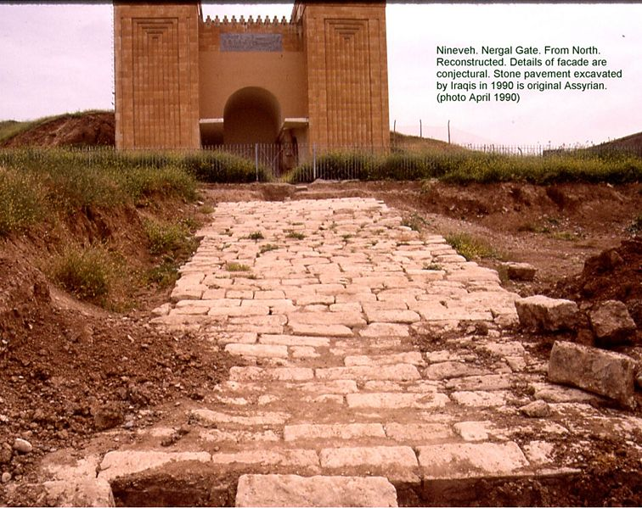
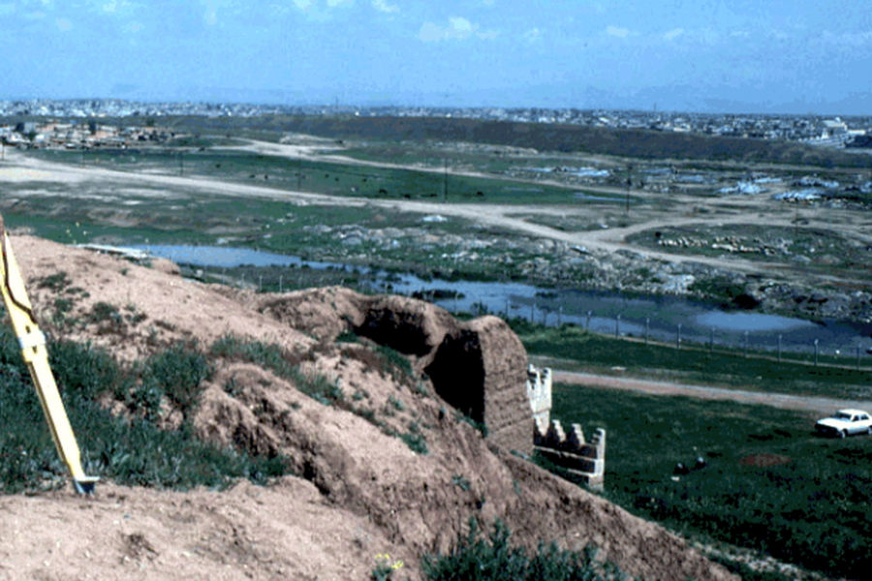
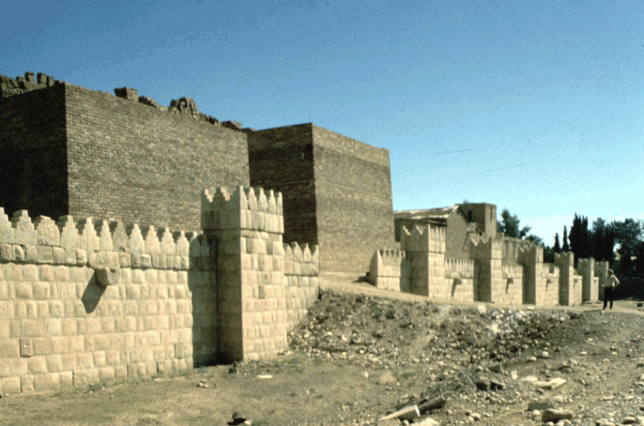
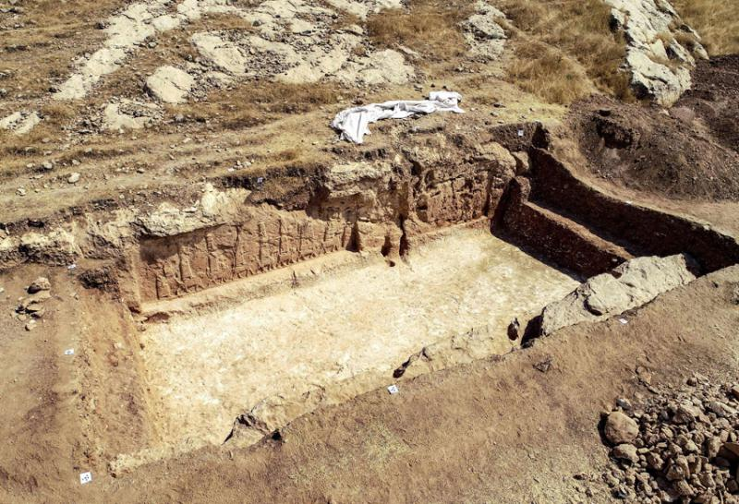
Nineveh archeological site - near modern Mosel

Slide 31
Conclusions from Jonah
Message for Preachers:
Never prejudge an audience.
Don't try to avoid the responsibility God has placed on you.
Control anger -- an angry preacher is not helpful to God.
Message to all Christians:
Don't have a selfish, narrow-minded, sectarian spirit.
Be concerned for all the lost, whoever and wherever they are.
Don’t let pride in accomplishments result in anger when we don’t like the outcome.
It is important to have the right attitude when we pray.
- Prayers said in anger are less likely to be effective.
Message to non-Christians:
God loves you regardless of your past.
Destruction is coming ... but
- God sent Christ to reveal His will and save you.
- Salvation is available when there is true repentance and obedience.
- Today He has His preachers and teachers to warn you.

Slide 32
Final Thought
Finally, may the example of Nineveh's repentance remind us of what Jesus said:
Matt 12:41 "The men of Nineveh will rise up in the judgment with this generation and condemn it, because they repented at the preaching of Jonah; and indeed a greater than Jonah is here."
Nineveh repented at the preaching of Jonah.
We should repent at the preaching of One Who is much greater, Jesus Christ

Slide 33
Jonah
783 B.C. - 753 B.C. circa
Name means “Dove”
…”for I knew that you are a gracious God and merciful, slow to anger and abounding in steadfast love, and relenting from disaster”
(4:2b)
Running
from God
Running
to God
Running
with God
Running
ahead of God
First commission
of Jonah
Results of disobedience
Prayer of Jonah
Communication
with the Lord
Second commission of Jonah
Results
of obedience
Prejudice of Jonah
Lessons from the Lord
Chapter 2
Chapter 1
Chapter 3
Chapter 4
Theme
God’s infinite mercy for all people; our reluctance to share His mercy
Key Verses
2:9; 4:11
Jonah’s three days in the fish anticipates Christ’s death and resurrection.
The Ninevites’ salvation represents the salvation available to all people
in Christ (Mt. 12:39-41; Lk. 11:29-32)
Christ in
Jonah
Notes:
Jonah has the dubious honor of being the only prophet who ran away from his commission. However, God caught up with him and brought him to his knees. Jonah barely tells us anything about himself prior to his calling to Nineveh (Assyria) -- only that he was the son of Amittai. However, 2 Kings 14:25 tells us that Israel’s king, Jeroboam II “He restored the border of Israel from Lebo-hamath as far as the Sea of the Arabah, according to the word of the Lord, the God of Israel, which he spoke by his servant Jonah the son of Amittai, the prophet, who was from Gath-hepher.” We know that Jeroboam II reigned in the northern kingdom from 793-753 B.C. That means Jonah would have ministered in the northern kingdom at least thirty years prior to Assyria’s invasion of Israel in 722 B.C. Nineveh was the capital of Assyria. It could be that Jonah heard of Assyria’s impending invasion from other prophets, like Amos. If so, that would be one reason why Jonah fled as he did. Since Jesus uses Jonah’s imprisonment by the great fish as a foreshadowing of his death and resurrection, it argues against the idea that the book is allegorical or mythical, as some suggest. Unlike most other prophetic portions of the Old Testament, Jonah is a narrative of a single prophetic mission - to Nineveh - the great enemy and menace of Israel. The book can be divided into two commissions: (1) In chapters 1-2, he refused the first commission; (2) In chapter 3-4, after being pursued and humbled, Jonah obeys the second commission to preach to the Ninevites (although he wasn’t happy about it, 4:1). A brief outline has him running from God (chapter 1); running to God (chapter 2); running with God (chapter 3); running against God (chapter 4). I find it interesting that God answers Jonah’s self pity (where he uses a plant to sprout up and wither as a lesson that even the Ninevites deserved compassion) with a rhetorical question that closes out the book: “And should not I pity Nineveh, that great city, in which there are more than 120,000 persons who do not know their right hand from their left, and also much cattle?” Note: the inference that the 120,000 did not know their “right hand from the left” possibly implies a state of innocence making the number of inhabitants much greater (thought to be about 600,000 when it was captured in 612 B.C.).
Application
Be careful we do not become judgmental: salvation depends on God, not us. That’s a good thing. Like Jonah, we might be less gracious and merciful than God is (as demonstrated with the Ninevites).
Be careful about deciding who is worthy of salvation: the Pharisees griped about Jesus fraternizing with the sinners and publicans. Yet the spiritually sick are the very ones needing the gospel.
Be careful you do not see yourself as superior: The gospel is a the great equalizer and everyone deserves to hear it.
God longs after people. He wants the sinners outside (like Nineveh) to repent, and He wants sinners inside (like Jonah - he certainly had warts) to love the sinners who are outside.
Key thought: How about us? Is there anyone we are withholding the gospel from because we think their sin is too great and they are undeserving?

